Slide 1
The curse of dimensionality

Slide 2







About me
Esteban Sánchez
esteban.sanchez@immune.institute
Education
Physics UCM (2012-2018)
Data Science Kschool (2018)
Psychology UNED (currently) (2019-)
Experience
Data scientist jr at Indizen Technology (2017-2019)
Data scientist at Ernst & Young (2019)
Specialist data scientist at Vodafone- Big Data and AI (currently) (2019-)
Data science lead instructor al The Bridge (2020)
Introduction to Python
Data analysis

Slide 3
Outline
Dimensionality Reduction
The curse of dimensionality
Principal component analysis
Steps to calculate the projection matrix W
Explained variance
Considerations
Singular value decomposition
Linear discriminant analysis
Steps to calculate LDA
Scatter matrices
Discriminability
Kernel PCA
Kernel basic idea

Slide 4
The curse of dimensionality
Millions of features
Training extremely slow
Techniques to reduce dimensionality in a dataset (feature extraction):
Principal component analysis (PCA)
Singular value decomposition (SVD)
Linear discriminant analysis (LDA)
Kernel principal component analysis (KPCA)
Data compression

Slide 5
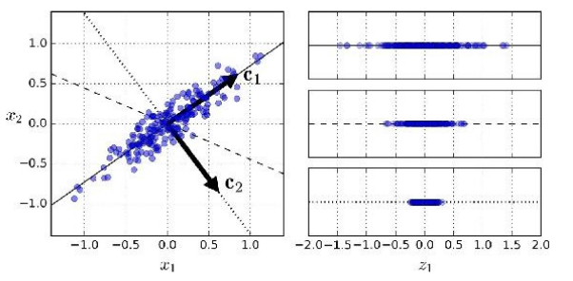
Principal component analysis
PCA helps us to:
Find the directions of maximum variance in high-dimensional data.
Project it onto a new subspace with equal or fewer dimensions than the original one..
The new feature axes are orthogonal to each other.
2D data plot
Possible chosen axes

Slide 6
Principal component analysis
Steps to calculate the projection matrix W
Standardize the d-dimensional dataset.
Construct the covariance matrix.
Decompose the covariance matrix into its eigenvectors and eigenvalues.
Sort the eigenvalues by decreasing order to rank the corresponding eigenvectors.
Select K eigenvectors which correspond to the k largest eigenvalues, where k is the dimensionality of the ner feature subspace.
Construct a projection matrix W from the “top” k eigenvectors
Transform the d-dimensional input dataset x using the projection matrix W to obtain the new k-dimensional feature subspace, z .
k ≤ d

Slide 7
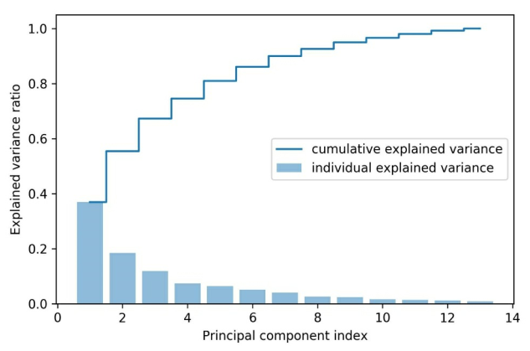
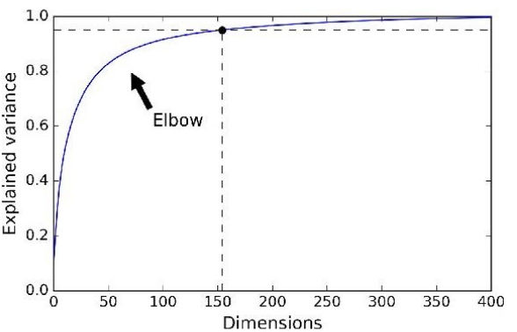
Principal component analysis
Explained variance

Slide 8
Principal component analysis
Considerations
PCA is very sensitive to data scale. It is very important to put original data in the same scale (mean zero and standard deviation = 1).
PCA only rotates the coordinates such that new directions are those of maximum variance no guarantee that this information is good for classification.
New variables (or components) does not have any business meaning.
We can use correlation matrix (instead of covariance) and it does not require normalized data.

Slide 9
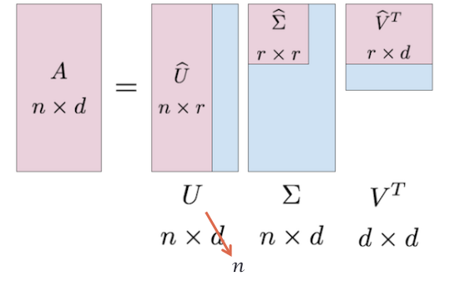
Singular value decomposition
Let A be a n × d matrix, then exists a factorization → A = UDVT
D is a diagonal matrix with non-negative entries, of same dimen- sion as A (n×d).
U, V are orthogonal matrices of dimension n × n and d × d respectively.
If we truncate U and D to take the first r components (r < d) we get an approximation of A’ ∼ U’ D’ V’.
D’ diagonal matrix of dimension r x r
U’ dimension n x r
We take U’ D’ (dimension n × d) such that ∥A − A’∥ is small.
Elements of D are called singular values.
PCA is a particular case of SVD where A ≡ correlation matrix (A = XTX)
There is always SVD factorization.
We need square and semi-positive defined matrix for the PCA decomposition to exist.
Columns of U are the eigenvectors of X X^T
Columns of V are the eigenvectors of X^T X
Square root of singular values of Σ are the eigenvalues of X X^T

Slide 10
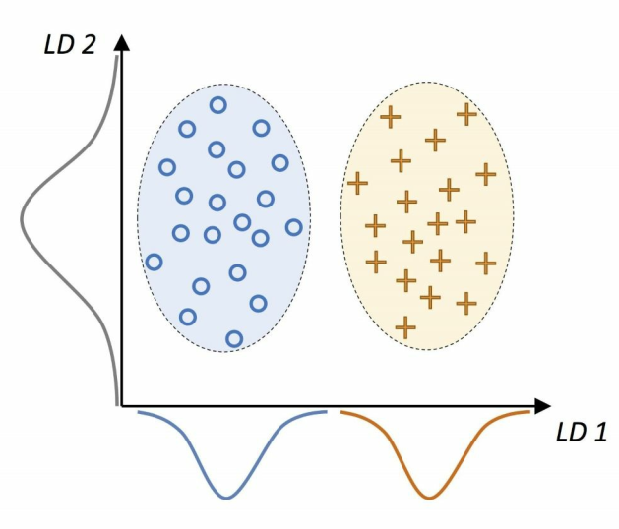
Linear discriminant analysis
The goal in LDA is to find the features subspace that optimizes class separability.

Slide 11

Linear discriminant analysis
Steps to calculate LDA
Standardize the d-dimensional dataset (d is the number of features).
For each class, compute the d-dimensional mean vector.
Construct the between-class scatter matrix SB and the within-class scatter matrix SW .
Compute the eigenvectors and corresponding eigenvalues of the matrix
Sort the eigenvalues by decreasing order to rank the corresponding eigenvectors.
Choose the k eigenvectors that correspond to the k largest eigenvalues to construct a d × k dimensional transformation matrix W ; the eigenvectors are the columns of this matrix.
Project the samples onto the new feature subspace using the transformation matrix W.

Slide 12



Linear discriminant analysis
Scatter matrices
Within-class scatter matrix:
Individual class scatter matrix:
Between-class scatter matrix:
.

Slide 13
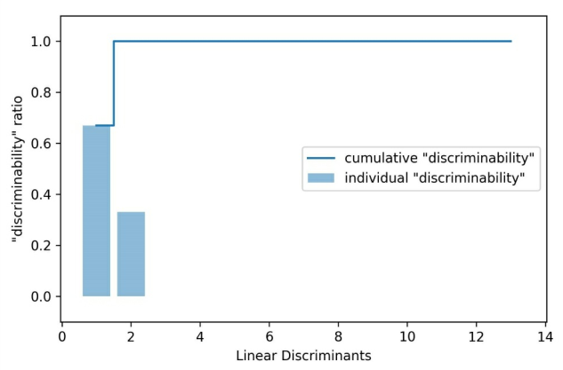
Linear discriminant analysis
Discriminability
Plot the linear discriminants by decreasing eigenvalues.

Slide 14
Kernel PCA
Nonlinear problems
Kernel PCA

Slide 15
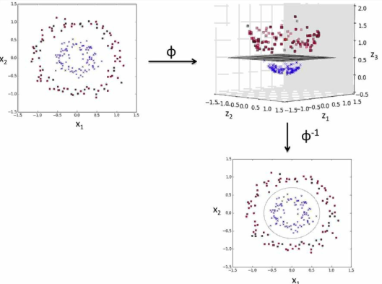
Kernel PCA
Kernel basic idea
Create nonlinear combinations of the original features to project them onto a higher-dimensional space via a mapping function φ where it becomes linearly separable.
φ(x1, x2) = (z1, z2, z3) = (x1, x2, x21 + x2) ← example
There are some known ways to do that:
Polynomial
Linear
Radial basis function (RBF)
Sigmoid
.

